Slide 1


How computers work
Fionn Hourican

Slide 2
The system bus

Slide 3
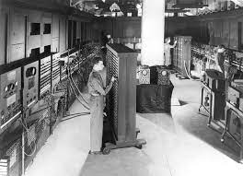
The background of the system bus
The system bus can be traced back to 1946 when the first large-scale, digital computer was used in the military to improve bomb designs.
The physicist John Mauchly designed the ENIAC (“Electronic Numerical Integrator And Computer”) in Philadelphia with the help of a young engineer J. Presper Eckert.
This computer was used to preform calculations which were previously done by “human computers” which were often highly educated, young women.

Slide 4
The purpose of the system busses

Slide 5
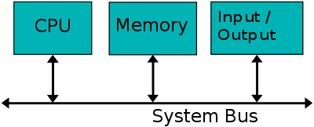
What is a system bus?
The system bus is made of wires & connectors which carry data between the main parts of the computer or computers
This includes all hardware and software parts of the computer.
The system bus can do so by combining the functions of different busses.

Slide 6
The system bus contains 3 busses
Address bus.
Data bus.
Control bus.

Slide 7
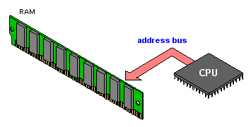
Address bus
The location of the data in memory is carried by the address bus.
Each location in memory has its own unique address.
The size of the address bus will affect the maximum number of memory locations that the CPU can access.
The size of the address is determined by the number of wires.
A 3-bit address has 3 signals, A0 – A2 and the max no. Of addresses is 2^3 = 8 addresses (16-bit addresses would have 2^16 addresses and so on).
The more signals an address bus has the more memory locations it has.
The more signals that are needed the harder an address bus is to be manufactured.

Slide 8
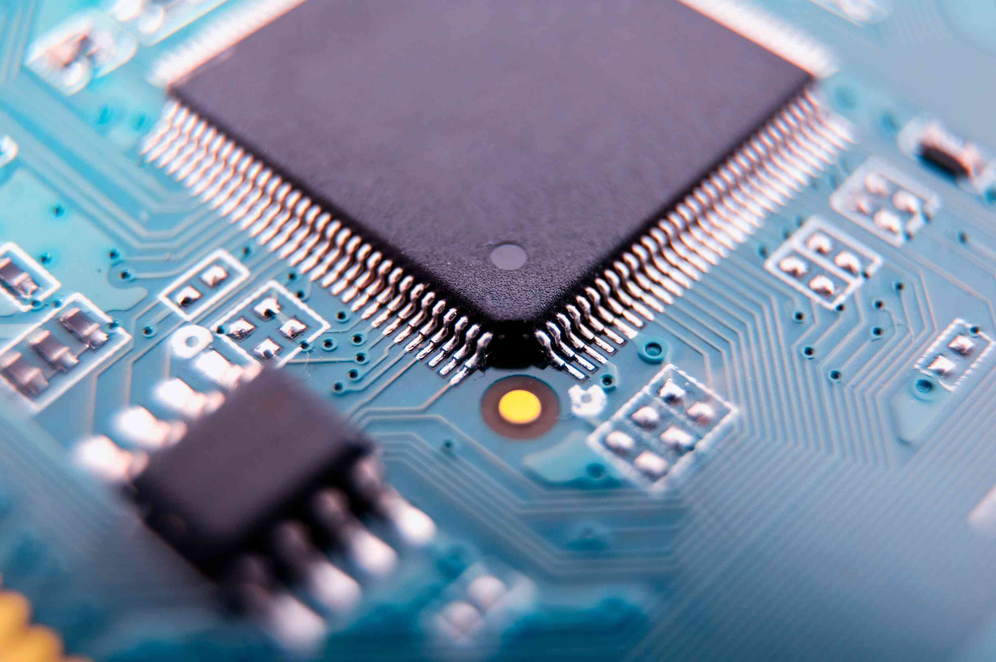
Data bus
Transfers data from one component to another on the motherboard or between two computers.
The amount of data a data bus can handle is called the “bandwidth”.
An 8-bit data bus shows numbers from 0 – 255.
This data is represented by 1’s & 0’s.
The CPU is involved.

Slide 9
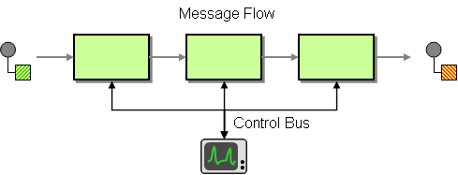
Control Bus
Carries control signals to & from the CPU.
signals when an allocation in the address bus is valid.
signals whether data is read from or written to an input/output device or memory location.
Contains interrupt signals.
Also contains reset and timing signals.

Slide 10
sources
ptg. (27 May 2019). Memorial Day Memories -- The Military's First Computer. Available: https://blog.goptg.com/memorial-day-memories-the-militarys-first-computer. Last accessed 28 Oct 2021.
Husted, H. (unknown). What is a Data Bus?. Available: https://www.easytechjunkie.com/what-is-a-data-bus.htm. Last accessed 28 Oct 2021.
techopedia. (2015). what does system bus mean?. Available: https://www.techopedia.com/definition/2307/system-bus. Last accessed 27th Oct 2021
Thornton, S. (2016). The Internal Processor Bus: data, address, and control bus. Available: https://www.microcontrollertips.com/internal-processor-bus-data-address-control-bus-faq/. Last accessed 28 Oct 2021.
Zhang F. (03 Jan 2020). History and Development of Bus. In: High-speed Serial Buses in Embedded Systems.. Available: https://link.springer.com/chapter/10.1007/978-981-15-1868-3_1. Last accessed 28 Oct 2021.

